Slide 1
Control of IS
IS controls are a set of procedures and technological measures to ensure secure and efficient operation of information within an organization.
Controlling an information system involves ensuring that the system operates efficiently, securely, and in alignment with organizational goals.
Effective control of an information system is an ongoing process that requires continuous monitoring, assessment, and improvement to adapt to new threats and changing organizational needs.
Information system controls can indeed be classified into two broad categories: general controls and application controls. Both are essential for ensuring the integrity, security, and efficiency of information systems.
General controls provide a secure and stable environment for information systems, while application controls ensure that specific applications process data correctly and produce accurate outputs.

Slide 2
General Controls
General controls are overarching policies and procedures that affect the entire information system environment.
They ensure the proper operation and security of the overall information system and include controls related to hardware, software, networks, and data.
General controls include administrative measures that restrict employee access to only those processes directly relevant to their duties, thereby limiting the damage an employee can do.
Some general Controls are:
Access Control
Physical control
Administrative control

Slide 3
General Controls
Access Controls:
Authentication Mechanisms: Password policies, multi-factor authentication, biometric systems.
Authorization Procedures: Role-based access control (RBAC), ensuring users have access only to the information and resources necessary for their roles.
Physical Controls:
Security of Facilities: Surveillance cameras, security guards, locked server rooms.
Environmental Controls: Air conditioning, fire suppression systems, and uninterruptible power supplies (UPS) to protect hardware.
Administrative Controls:
Security Policies and Procedures: Formal policies outlining security measures, incident response plans, and acceptable use policies.
Training and Awareness Programs: Regular security training for employees to ensure they understand security policies and best practices.

Slide 4
Application controls
Application controls are specific to individual applications and ensure that the applications function correctly, process data accurately, and produce reliable outputs.
Classified as input control, processing control and output control.
Input Controls:
Data Validation: Checks to ensure data entered into the system is accurate and complete (e.g., format checks, range checks).
Input Authorization: Ensuring that only authorized personnel can enter or modify data.

Slide 5
Application Controls
Processing Controls:
Run-to-Run Totals: Verifying that totals from one stage of processing match the totals from the next stage.
Transaction Logs: Maintaining logs of all transactions processed by the system for audit and verification purposes.
Output Controls:
Reconciliation Procedures: Comparing outputs with input totals or other control totals to ensure accuracy.
Output Distribution: Ensuring that outputs are distributed only to authorized users.

Slide 6
Application Controls
Integrity Controls:
Checksum and Hashing: Verifying data integrity through checksums and hashing algorithms.
Data Matching: Ensuring data consistency across different systems or modules.
Error Handling:
Error Reporting: Mechanisms to report errors encountered during processing.
Error Correction Procedures: Procedures for identifying, reporting, and correcting errors.

Slide 7
Examples of General vs. Application Controls in Practice
A company has a policy that all systems must be protected by a firewall and that employee access to the network is controlled via multi-factor authentication. These controls ensure the security and integrity of the entire information system infrastructure.
In a payroll application, data validation checks ensure that only valid employee IDs and pay rates are entered. During processing, the application uses run-to-run totals to ensure the total pay calculated matches the expected amount based on inputs. Finally, the application generates payroll reports that are reconciled with the original input data to verify accuracy.

Slide 8
Network Information Systems
Controls in network information systems are critical to ensuring the confidentiality, integrity, and availability of data as it is transmitted and processed across networks. These controls can be categorized into various types, including preventive, detective, and corrective controls.
Access Controls
Authentication: Methods like passwords, multi-factor authentication (MFA), biometrics, and digital certificates to verify user identities before granting access to the network.
Authorization: Role-based access control (RBAC) and access control lists (ACLs) to ensure users can only access resources necessary for their roles.
Network Segmentation: Dividing the network into segments or subnets to limit access and reduce the spread of potential attacks.

Slide 9
Network Information Systems
Network Security Controls
Firewalls: Devices or software that monitor and control incoming and outgoing network traffic based on predefined security rules.
Intrusion Detection and Prevention Systems (IDS/IPS): Tools that monitor network traffic for suspicious activity and potential threats, and can take action to block or mitigate those threats.
Virtual Private Networks (VPNs): Secure connections over the internet that encrypt data to ensure privacy and protection from eavesdropping.
Data Integrity Controls
Encryption: Encrypting data in transit (e.g., SSL/TLS for web traffic, IPsec for network traffic) and at rest to protect it from unauthorized access or tampering.
Hashing: Using hash functions to verify data integrity by comparing hash values before and after transmission.

Slide 10
Network Information Systems
Monitoring and Logging
Network Monitoring: Continuous monitoring of network traffic to identify unusual patterns, potential breaches, and performance issues. Tools like network analyzers and monitoring software (e.g., Wireshark, SolarWinds) are commonly used.
Logging: Recording network activity logs to detect, analyze, and respond to security incidents. Logs can include firewall logs, IDS/IPS logs, and access logs.
Incident Response and Management
Incident Response Plan: Having a structured plan for detecting, responding to, and recovering from network security incidents. This includes identifying roles, responsibilities, and communication channels.
Forensic Analysis: Investigating incidents to determine their cause, impact, and how to prevent recurrence.

Slide 11
Network Information Systems
Physical Security Controls
Secure Access to Network Hardware: Restricting physical access to routers, switches, servers, and other critical network infrastructure through locked rooms, security cameras, and access control systems.
Environmental Controls: Ensuring proper environmental conditions (temperature, humidity) to protect network equipment from physical damage.
Configuration and Change Management
Configuration Management: Maintaining an inventory of network devices and their configurations, ensuring that only authorized changes are made.
Patch Management: Regularly updating network devices and software to fix vulnerabilities and improve security

Slide 12
Network Information Systems
Redundancy and Fault Tolerance
Redundant Network Paths: Implementing multiple network paths to ensure continuous availability in case one path fails.
High Availability Solutions: Using load balancers, failover mechanisms, and clustering to maintain network uptime.
Compliance and Auditing
Compliance Checks: Ensuring that the network complies with relevant laws, regulations, and standards (e.g., GDPR, HIPAA, PCI-DSS).
Regular Audits: Conducting regular security audits and assessments to identify vulnerabilities and ensure controls are effective.

Slide 13
Audit of IS
An audit of information systems (IS) involves a comprehensive evaluation of the systems, processes, and controls in place to ensure that the organization's information assets are adequately protected, accurately processed, and efficiently managed.
The primary objective of an IS audit is to ensure the integrity, confidentiality, availability, and reliability of data and information systems.
This involves examining the effectiveness of the information systems in supporting the organization's objectives, the accuracy and reliability of data processing, and compliance with applicable laws, regulations, and policies.

Slide 14
Objective of IS audit
Key Objectives of an Information System Audit
Evaluate the Effectiveness of Controls: Assess whether the controls in place are adequate to protect the organization's information assets from various risks, including unauthorized access, data breaches, and operational failures.
Ensure Data Integrity and Reliability: Verify that data processed by the information systems is accurate, complete, and reliable.
Assess Compliance: Ensure that the organization's information systems comply with relevant laws, regulations, standards, and internal policies.
Review System Efficiency and Performance: Evaluate the efficiency and performance of the information systems in supporting business operations and achieving organizational goals.
Identify Security Vulnerabilities: Detect vulnerabilities and weaknesses in the information systems that could be exploited by cyber threats.
Evaluate Business Continuity and Disaster Recovery Plans: Ensure that there are adequate measures in place to recover from disasters and maintain business continuity.

Slide 15
Benefits of IS audit
Benefits of Information System Audits
Improved Security: Identifying and addressing security vulnerabilities helps protect the organization’s information assets from threats.
Enhanced Data Integrity: Ensuring the accuracy and reliability of data supports better decision-making and operational efficiency.
Regulatory Compliance: Audits help ensure that the organization complies with applicable laws, regulations, and standards, reducing the risk of legal penalties.
Risk Management: Identifying and mitigating risks related to information systems helps in minimizing potential losses.
Operational Efficiency: Evaluating the efficiency of information systems can lead to improvements in processes and technology, reducing costs and increasing productivity.
Confidence in IT Systems: Providing assurance to stakeholders that the information systems are reliable and well-managed.

Slide 16
Examples
Examples of IS Audit Activities
Access Control Audit: Reviewing user access rights to ensure that only authorized personnel have access to critical systems and data.
System Configuration Audit: Verifying that systems are configured according to security best practices and organizational policies.
Data Backup and Recovery Audit: Assessing the effectiveness of backup procedures and testing the organization’s ability to recover data in the event of a disaster.
Compliance Audit: Checking for adherence to industry regulations such as GDPR, HIPAA, or PCI-DSS.
Network Security Audit: Evaluating the security of the organization’s network infrastructure, including firewalls, routers, and intrusion detection systems.

Slide 17
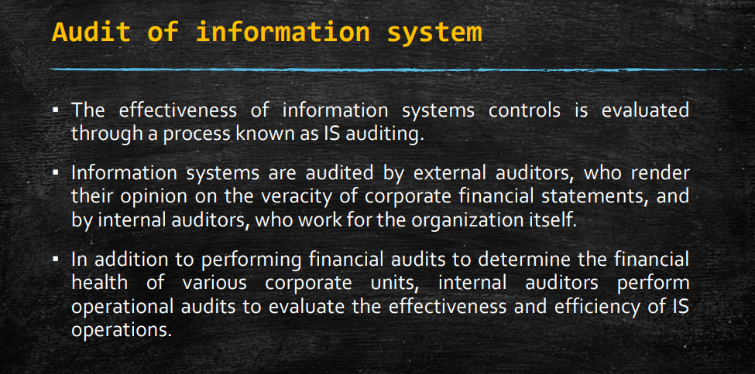

Slide 18
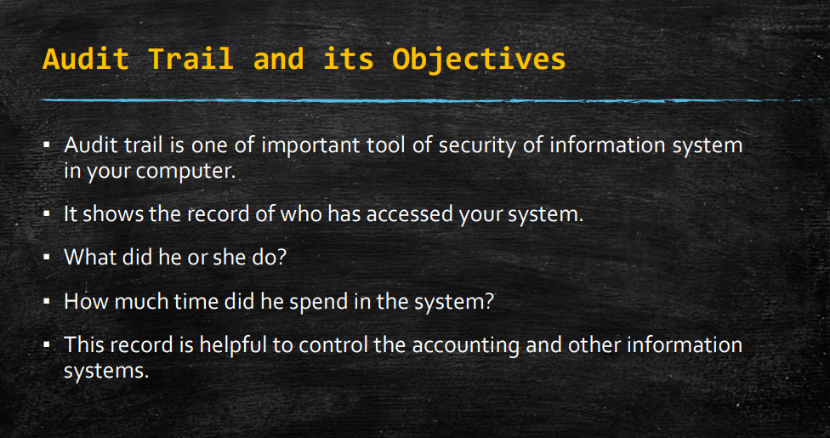

Slide 19
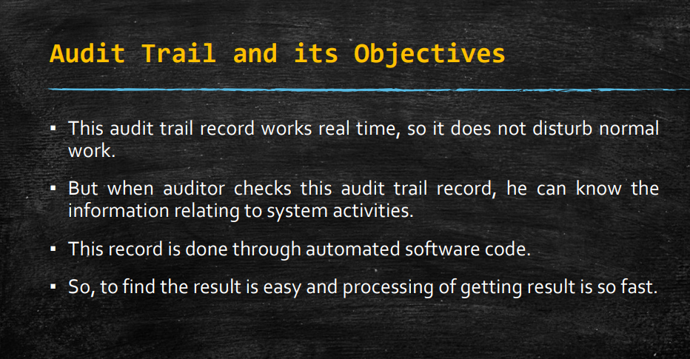

Slide 20
Audit trail
An audit trail in information systems is a detailed, chronological record that tracks all the activities, events, and transactions occurring within the system.
This log records information about who did what, when, and where, providing a way to trace all actions back to their source.
An audit trail includes timestamps, user identifiers, and details of the operations performed, ensuring that every modification, access, or transaction within the system is documented.

Slide 21
Objectives of audit trail
Ensure Accountability:
User Accountability: By recording the actions of individual users, an audit trail holds them accountable for their activities. This discourages unauthorized or malicious actions since users know their activities are being logged.
System Accountability: Tracks system processes and transactions, ensuring that every action within the system can be traced and verified.
Facilitate Security:
Detecting Unauthorized Access: An audit trail helps in identifying unauthorized access attempts or unusual activities that may indicate a security breach.
Forensic Analysis: In case of a security incident, an audit trail provides crucial evidence that can be used to understand how the breach occurred, what was affected, and how to prevent future incidents.

Slide 22
Objectives of audit trail
Support Compliance:
Regulatory Compliance: Many regulations and standards (e.g., GDPR, HIPAA, SOX, PCI-DSS) require organizations to maintain detailed logs of system activities. An audit trail helps in meeting these legal and regulatory requirements.
Policy Enforcement: Ensures that internal policies and procedures are being followed by providing evidence of adherence or highlighting deviations.
Maintain Data Integrity:
Accuracy and Completeness: Ensures that all data processing activities are accurately recorded, providing a mechanism to verify the integrity of data.
Change Management: Tracks changes to data and systems, helping to ensure that modifications are authorized and properly documented.

Slide 23
Objectives of audit trail
Enhance Operational Transparency:
Process Verification: Provides transparency into system operations and business processes, allowing for verification that processes are being executed correctly.
Audit Support: Facilitates internal and external audits by providing detailed logs that auditors can review to assess the adequacy of controls and the integrity of data.
Enable Error Detection and Correction:
Identifying Errors: Helps in detecting errors in data processing or system operations by providing a detailed record of activities.
Corrective Actions: Supports the identification of the root cause of errors, enabling timely and effective corrective actions.

Slide 24
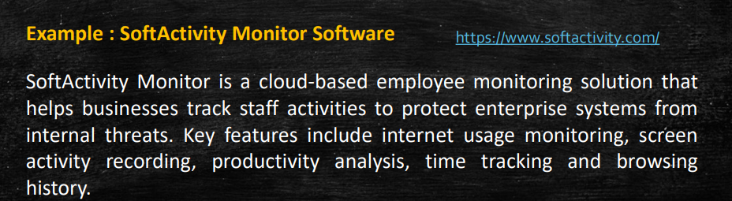

Slide 25
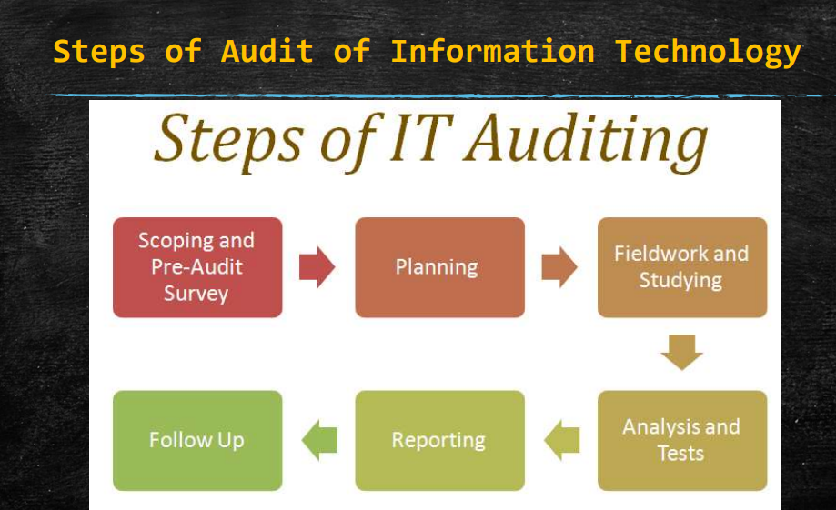

Slide 26
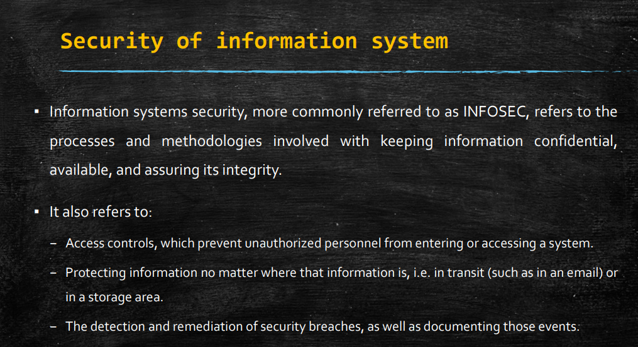
Security of information systems
Securing information systems is crucial for protecting the confidentiality, integrity, and availability of data and resources within an organization.
Effective security measures help prevent unauthorized access, data breaches, cyber attacks, and other security threats.

Slide 27
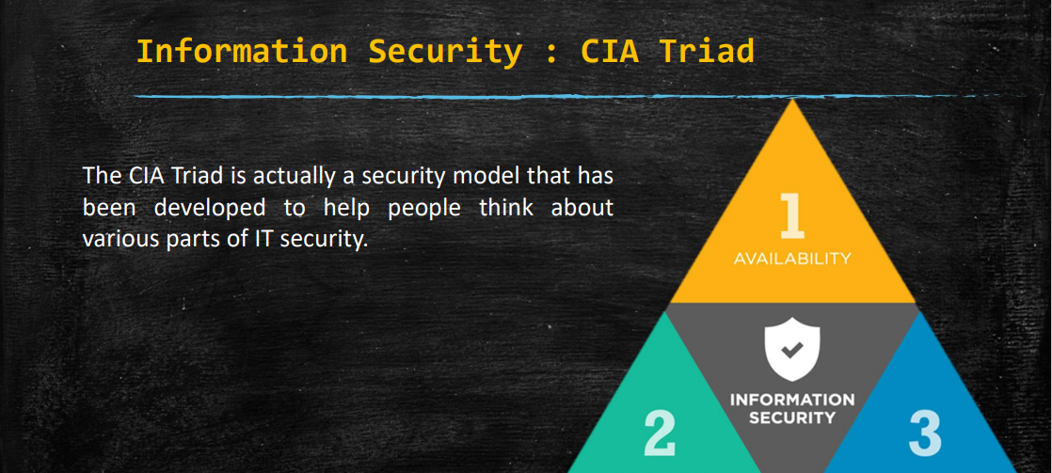
Information Security : CIA triad

Slide 28
Confidentiality
Definition: Confidentiality ensures that information is accessible only to those who are authorized to access it, protecting it from unauthorized disclosure or access.
Objectives and Measures:
Access Controls: Implement mechanisms such as authentication, authorization, and encryption to control access to sensitive information.
Data Encryption: Encrypt sensitive data to ensure that even if it is intercepted, it cannot be read without proper decryption keys.
User Awareness: Educate users about the importance of protecting sensitive information and the risks associated with unauthorized disclosure.

Slide 29
Integrity
Definition: Integrity ensures that information is accurate, complete, and reliable, and has not been tampered with or altered in an unauthorized manner.
Objectives and Measures:
Data Validation: Implement validation checks to ensure the accuracy and completeness of data inputs and outputs.
Data Hashing: Use cryptographic hashing algorithms to create checksums or hashes of data to verify its integrity.
Version Control: Maintain version control mechanisms to track changes to data and ensure that only authorized changes are made.
Audit Trails: Implement audit trails to record and monitor changes to data and systems, facilitating detection of unauthorized modifications.

Slide 30
Availability
Definition: Availability ensures that information and resources are accessible and usable when needed, without interruption or degradation of service.
Objectives and Measures:
Redundancy: Implement redundant systems and failover mechanisms to minimize downtime and ensure continuous availability.
Backup and Recovery: Regularly back up data and implement robust disaster recovery plans to recover quickly from system failures or disasters.
Resource Monitoring: Monitor system performance and resource utilization to identify and address potential bottlenecks or issues affecting availability.
Denial of Service (DoS) Protection: Implement measures to prevent or mitigate DoS attacks that can disrupt or degrade service availability.

Slide 31
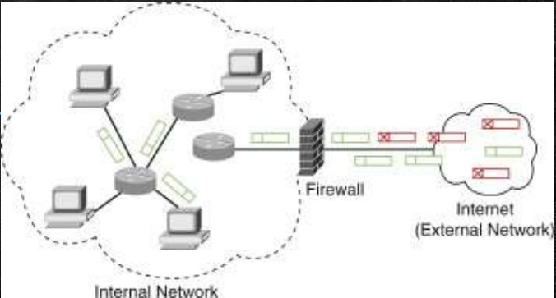
Firewall

Slide 32
Firewall
A firewall is a network security device or software that monitors and controls incoming and outgoing network traffic based on predetermined security rules.
It acts as a barrier between a trusted internal network and untrusted external networks, such as the internet, to prevent unauthorized access, malicious attacks, and data breaches.
Firewalls play a crucial role in protecting information systems by enforcing security policies and filtering traffic to allow only authorized communications.

Slide 33
How firewall works?
How Firewalls Work:
Packet Filtering:
Firewalls inspect packets of data as they pass through, examining their source, destination, port numbers, and other attributes.
Based on predefined rules, the firewall decides whether to allow, block, or forward each packet.
Stateful Inspection:
Some modern firewalls use stateful inspection, which keeps track of the state of active connections.
It monitors the context of traffic flows and allows packets that belong to established connections while blocking unauthorized or suspicious traffic.
Proxying:
Firewalls can act as intermediaries for certain types of traffic, such as web traffic or email.
They receive requests from clients, retrieve the requested content on behalf of the client, inspect it, and then forward it to the client.
This proxying process adds an additional layer of security by hiding the internal network structure from external users.

Slide 34
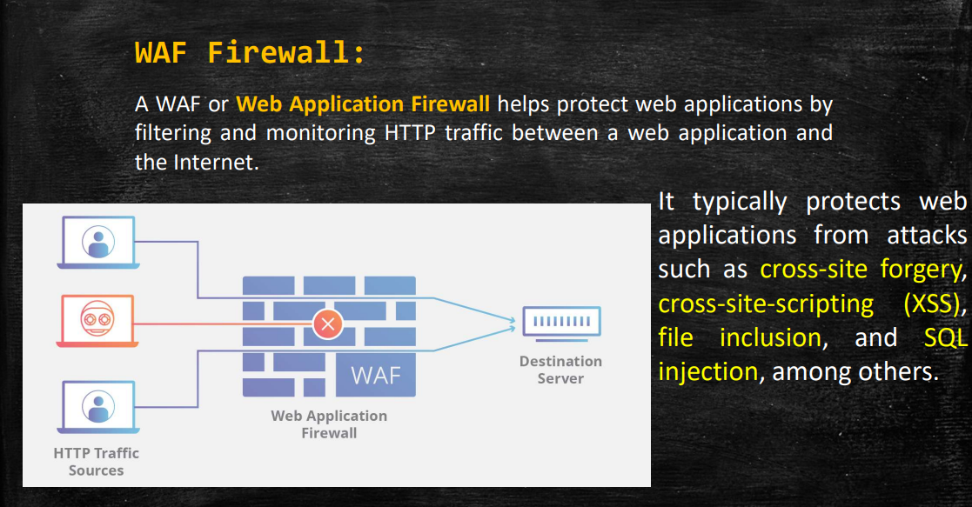

Slide 35
WAF
A web application firewall (WAF) is a specialized security tool designed to protect web applications from a variety of cyber threats, including common web vulnerabilities and attacks.
It operates at the application layer (Layer 7) of the OSI model, providing an additional layer of defense beyond traditional network firewalls.
Web application firewalls analyze and filter HTTP requests and responses, inspecting web traffic for malicious content, suspicious behavior, and known attack patterns.

Slide 36
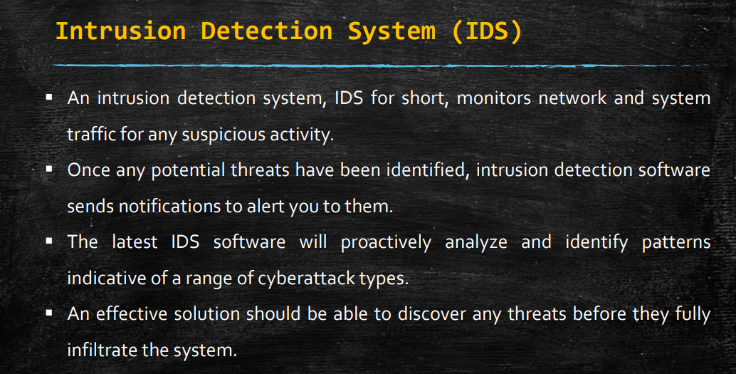

Slide 37
IDS
An Intrusion Detection System (IDS) is a security tool or application designed to monitor network or system activities for malicious or suspicious behavior and to detect and respond to security threats in real-time.
IDSs play a crucial role in identifying and mitigating cybersecurity incidents by continuously analyzing network traffic, system logs, and other sources of security-related data for signs of unauthorized access, intrusion attempts, or malicious activity.

Slide 38
IDS
Types of Intrusion Detection Systems:
Network-based Intrusion Detection System (NIDS):
Monitors network traffic in real-time, analyzing packets and traffic patterns to detect signs of suspicious activity or known attack signatures.
Positioned at strategic points within the network, such as at network gateways or on internal network segments.
Can detect threats such as port scans, denial-of-service (DoS) attacks, and network-based exploits.
Host-based Intrusion Detection System (HIDS):
Installed on individual hosts or endpoints, such as servers, workstations, or cloud instances.
Monitors system logs, file integrity, registry changes, and other host-specific events to detect unauthorized access or malicious activity.
Provides visibility into host-level security events and can detect threats such as malware infections, unauthorized access attempts, and system configuration changes.

Slide 39
Benefits IDS
Benefits of Intrusion Detection Systems:
Early Threat Detection:
IDSs enable early detection of security threats, allowing organizations to identify and respond to incidents before they escalate into major breaches.
Enhanced Incident Response:
IDSs provide valuable information and alerts that facilitate rapid incident response, minimizing the impact of security incidents and reducing the time to remediation.
Improved Security Posture:
By continuously monitoring network and system activities, IDSs help organizations maintain a proactive security posture and defend against a wide range of cyber threats.
Compliance and Regulatory Requirements:
IDSs help organizations meet compliance requirements by providing mechanisms for monitoring and auditing security controls, as required by regulations such as PCI DSS, HIPAA, and GDPR.
Threat Intelligence and Visibility:
IDSs provide valuable threat intelligence and visibility into network and system security events, helping organizations understand their threat landscape and identify emerging threats.

Slide 40
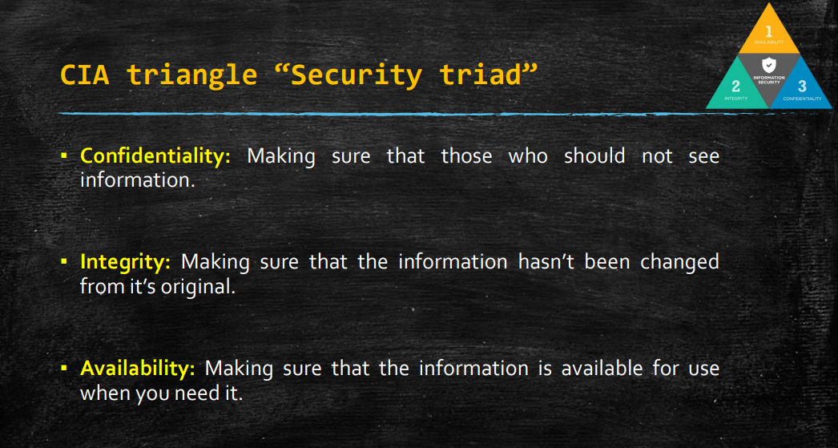

Slide 41
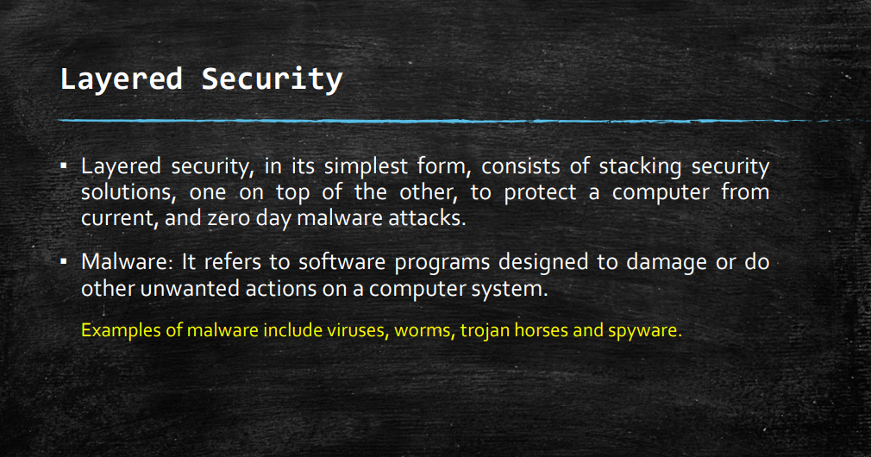

Slide 42
Layered Security
Layered security, also known as defense-in-depth, is a cybersecurity strategy that involves implementing multiple layers of security controls, mechanisms, and countermeasures throughout an information system to provide comprehensive protection against a wide range of threats and vulnerabilities.
Each layer of security adds an additional level of defense, helping to mitigate the risk of security breaches and minimize the impact of potential cyber attacks.
The goal of layered security is to create multiple barriers and checkpoints that an attacker must overcome, making it more difficult for them to compromise the system or access sensitive data.

Slide 43
Consumer layered security strategy
A consumer layered security strategy is a personalized approach to protecting one's digital life and personal information from various cyber threats.
While individuals may not have the same resources as large organizations, they can still implement effective security measures by adopting a layered approach.
Secure Passwords and Authentication:
Strong Passwords: Use complex passwords that include a mix of letters, numbers, and special characters. Avoid using easily guessable information like birthdays or common phrases.
Multi-Factor Authentication (MFA): Enable MFA wherever possible, especially for important accounts like email, banking, and social media. This adds an extra layer of security by requiring a second form of verification, such as a code sent to your phone.

Slide 44
Consumer layered security strategy
2. Endpoint Protection:
Antivirus Software: Install reputable antivirus software on all your devices and keep it updated to defend against malware, viruses, and other threats.
Firewall: Enable firewalls on your devices to monitor and control incoming and outgoing network traffic.
3. Safe Internet Practices:
Secure Browsing: Use secure connections (HTTPS) when browsing the web, especially for sensitive activities like online banking or shopping.
Avoid Phishing: Be cautious of unsolicited emails, messages, or links from unknown sources. Avoid clicking on suspicious links or downloading attachments from unfamiliar senders.
Ad Blockers: Consider using ad blockers and script blockers to prevent malicious ads and scripts from executing on websites.

Slide 45
Consumer layered security strategy
4. Software Updates and Patch Management:
Keep Software Updated: Regularly update your operating system, applications, and software to patch security vulnerabilities and protect against known exploits.
Automatic Updates: Enable automatic updates whenever possible to ensure you receive critical security patches in a timely manner.
5. Data Backup and Recovery:
Regular Backups: Back up your important files and data regularly to an external hard drive, cloud storage, or a dedicated backup service.
Offsite Backup: Store backups in a separate location from your primary devices to protect against physical damage, theft, or disasters.

Slide 46
Consumer layered security strategy
6. Privacy and Identity Protection:
Privacy Settings: Review and adjust the privacy settings on your devices, apps, and social media accounts to limit the amount of personal information shared online.
Identity Theft Protection: Consider using identity theft protection services or monitoring tools to detect suspicious activity related to your personal information.
7. Education and Awareness:
Stay Informed: Stay up-to-date on the latest cybersecurity threats, trends, and best practices through reputable sources, such as cybersecurity blogs, news websites, or official security advisories.
Security Awareness: Educate yourself and your family members about common cybersecurity risks and how to recognize and respond to potential threats.

Slide 47
Consumer layered security strategy
8. Secure Wi-Fi and Network Connections:
Secure Wi-Fi: Secure your home Wi-Fi network with a strong, unique password and encryption (WPA2 or WPA3).
Guest Network: Set up a separate guest network for visitors to your home to isolate their devices from your main network.
9. Physical Security:
Device Protection: Use physical security measures like device locks or biometric authentication (fingerprint or face recognition) to prevent unauthorized access to your devices.
Secure Storage: Keep your devices, backup drives, and physical documents containing sensitive information in a secure and locked location when not in use.

Slide 48
Enterprise layered security strategy
An enterprise layered security strategy is a comprehensive approach to protecting an organization's digital assets, sensitive data, and infrastructure from a wide range of cyber threats.
This strategy involves deploying multiple layers of security controls, mechanisms, and countermeasures across various levels of the organization's IT environment to create a robust defense-in-depth posture.
1. Perimeter Security:
Firewalls: Deploy next-generation firewalls (NGFW) at the network perimeter to monitor and control inbound and outbound traffic, block malicious connections, and prevent unauthorized access.
Intrusion Prevention Systems (IPS): Implement IPS solutions to detect and block network-based attacks, including exploits, malware, and intrusion attempts.

Slide 49
Enterprise layered security strategy
2. Network Security:
Network Segmentation: Segment the network into multiple zones or segments with different levels of trust and access controls to contain and isolate potential security breaches.
Virtual Private Network (VPN): Require the use of VPNs for remote access to corporate networks, encrypting data in transit and providing secure access to internal resources.
3. Endpoint Security:
Endpoint Protection Platforms (EPP): Deploy EPP solutions on endpoints (workstations, servers, mobile devices) to detect, prevent, and respond to malware, ransomware, and other endpoint threats.
Mobile Device Management (MDM): Implement MDM solutions to enforce security policies, control access, and manage mobile devices accessing corporate resources.

Slide 50
Enterprise layered security strategy
4. Identity and Access Management (IAM):
Single Sign-On (SSO): Implement SSO solutions to streamline user authentication and access management across multiple applications and services while enforcing strong authentication policies.
Privileged Access Management (PAM): Use PAM solutions to manage and monitor privileged accounts, limiting access to sensitive systems and data and enforcing least privilege principles.
5. Data Security:
Data Encryption: Encrypt sensitive data at rest, in transit, and in use using encryption algorithms and key management practices to protect against unauthorized access and data breaches.
Data Loss Prevention (DLP): Deploy DLP solutions to monitor, classify, and prevent the unauthorized transmission or exfiltration of sensitive data across the network and endpoints.

Slide 51
Enterprise layered security strategy
6. Application Security:
Secure Development Lifecycle (SDL): Implement secure coding practices, code reviews, and vulnerability assessments throughout the software development lifecycle to minimize the risk of application-layer vulnerabilities.
Web Application Firewalls (WAF): Deploy WAF solutions to protect web applications from common attacks, including SQL injection, cross-site scripting (XSS), and application-layer exploits.
7. Cloud Security:
Cloud Access Security Brokers (CASB): Implement CASB solutions to provide visibility, control, and security for cloud applications and services, enforcing security policies and compliance requirements.
Security Orchestration, Automation, and Response (SOAR): Use SOAR platforms to automate incident response processes, streamline security operations, and improve response times to security incidents.

Slide 52
Enterprise layered security strategy
8. User Education and Awareness:
Security Training: Provide regular security awareness training and education to employees to raise awareness of cybersecurity risks, best practices, and policies.
Phishing Simulation: Conduct phishing simulation exercises to test and reinforce employees' ability to recognize and report phishing attempts and social engineering tactics.
9. Incident Detection and Response:
Security Information and Event Management (SIEM): Deploy SIEM solutions to collect, correlate, and analyze security event data from across the organization's IT environment, enabling proactive threat detection and incident response.
Threat Hunting: Conduct proactive threat hunting activities to identify and investigate potential security threats and vulnerabilities before they escalate into security incidents.

Slide 53
Enterprise layered security strategy
10. Regulatory Compliance and Governance:
Compliance Frameworks: Align security practices with industry regulations, standards, and compliance frameworks (e.g., GDPR, PCI DSS, HIPAA) to ensure regulatory compliance and minimize legal and financial risks.
Risk Management: Implement risk management processes to identify, assess, and prioritize security risks, and develop mitigation strategies to address identified vulnerabilities and threats.
11. Continuous Monitoring and Improvement:
Security Metrics: Define key performance indicators (KPIs) and security metrics to measure the effectiveness of security controls, monitor security posture, and track progress over time.
Security Testing: Conduct regular security assessments, vulnerability scans, penetration testing, and red team exercises to identify weaknesses, validate security controls, and improve overall security resilience.

Slide 54
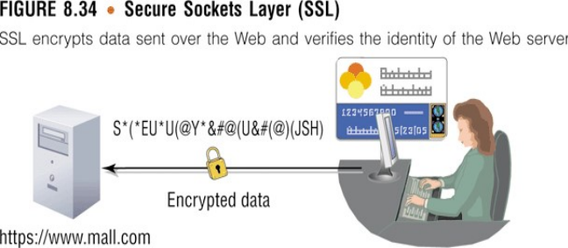
SSL (Secure Sockets Layer) Certificate
SSL (Secure Sockets Layer) certificates are digital certificates that encrypt data transmitted between a web server and a user's web browser, ensuring that sensitive information such as login credentials, personal details, and financial transactions remains secure and private.

Slide 55
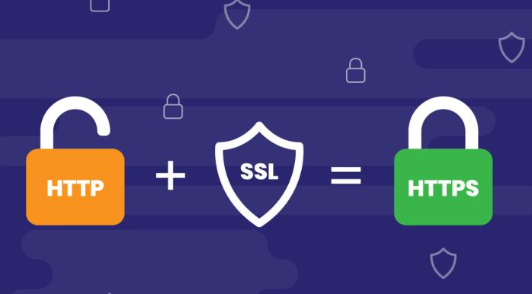
SSL

Slide 56
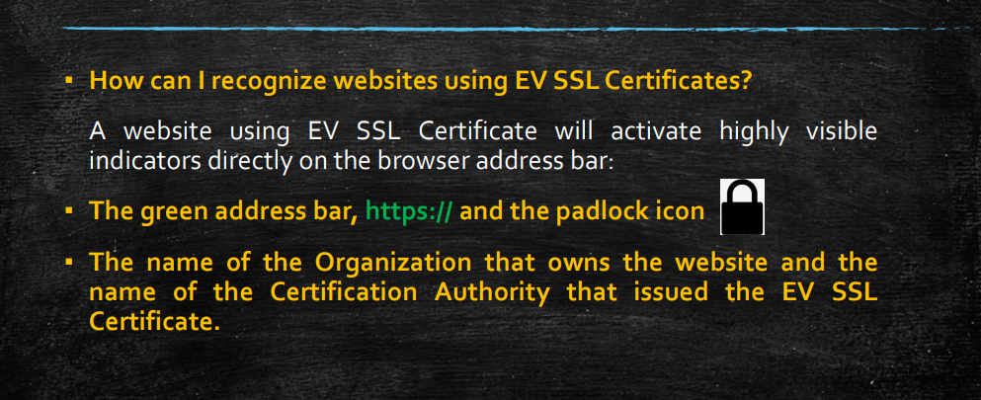

Slide 57
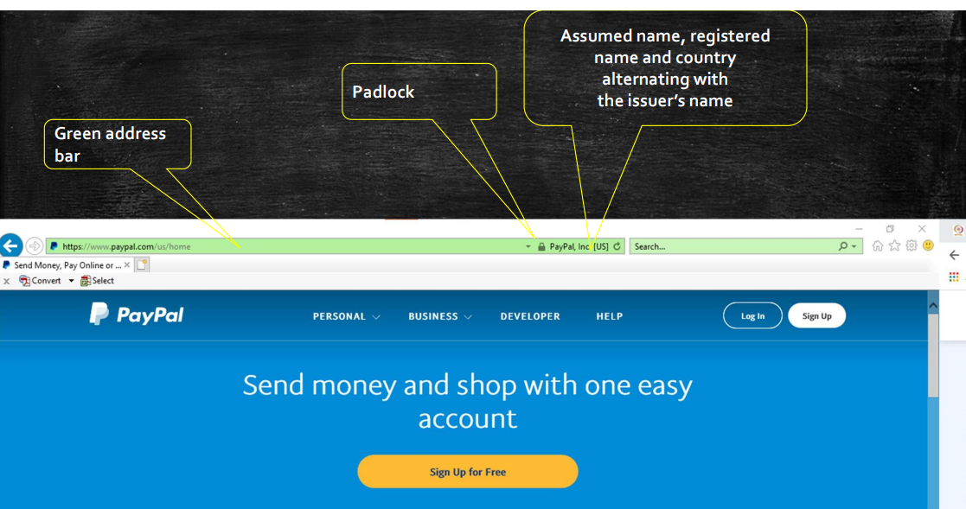

Slide 58
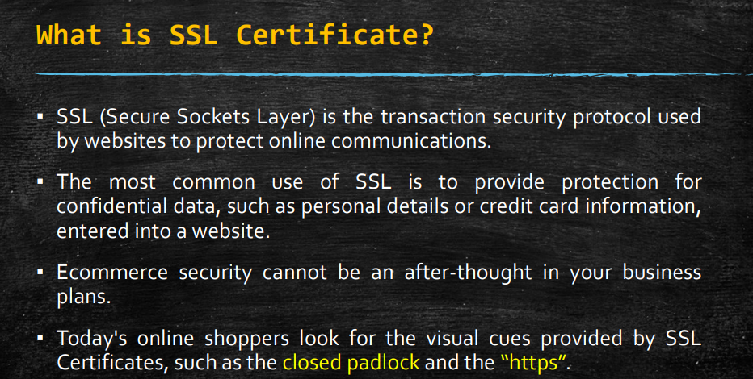

Slide 59
Key Features
1. Encryption and Security:
Data Encryption: SSL certificates use cryptographic protocols to encrypt data transmitted over the internet, preventing unauthorized parties from intercepting and reading sensitive information.
Data Integrity: SSL certificates also ensure data integrity by verifying that the data transmitted has not been tampered with or altered during transit.
2. Authentication:
Server Authentication: SSL certificates authenticate the identity of the web server to ensure that users are connecting to the intended website and not a malicious impersonator.
Certificate Authority (CA) Validation: SSL certificates are issued by trusted Certificate Authorities (CAs) after verifying the identity and ownership of the website.
3. Trust Indicators:
Padlock Icon: Websites secured with SSL certificates display a padlock icon in the web browser's address bar, indicating that the connection is secure.
HTTPS Protocol: SSL-secured websites use the HTTPS (Hypertext Transfer Protocol Secure) protocol, which is indicated by "https://" in the URL, providing users with visual assurance of security.

Slide 60
Types of SSL Certificate
Types of SSL Certificates:
Domain Validated (DV) Certificates: DV certificates provide basic encryption and verify domain ownership, making them suitable for personal websites, blogs, or small businesses.
Organization Validated (OV) Certificates: OV certificates authenticate the identity of the organization in addition to domain ownership, providing higher assurance and trust for businesses and organizations.
Extended Validation (EV) Certificates: EV certificates undergo the most rigorous validation process, including verification of legal entity and physical address, and display the organization's name prominently in the browser's address bar with a green padlock icon.

Slide 61
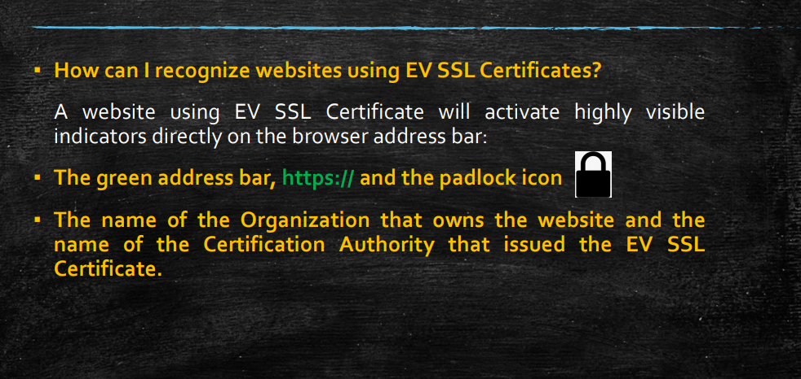

Slide 62
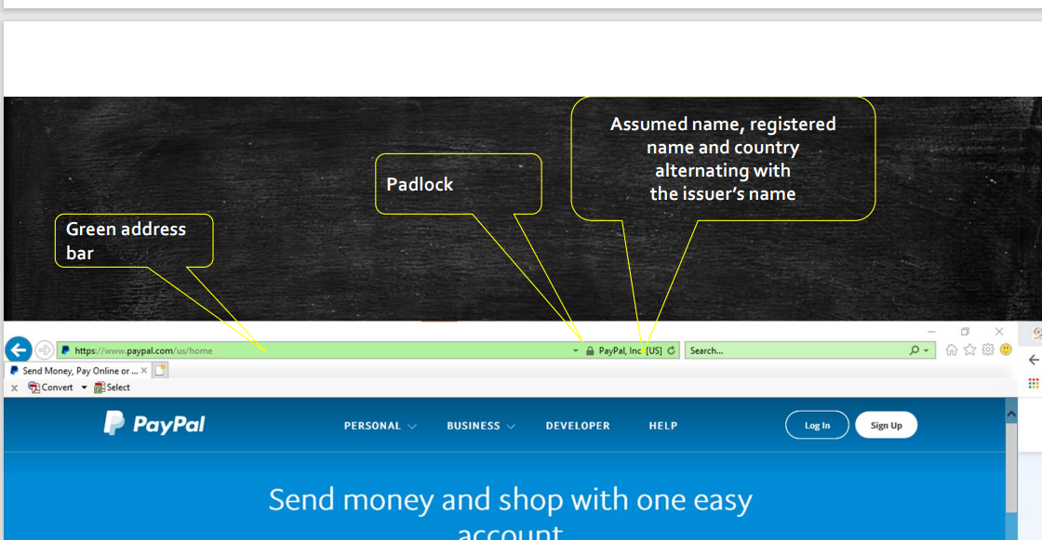

Slide 63
Benefits
Benefits:
Security: SSL certificates protect sensitive data from interception and unauthorized access, enhancing security for both website owners and users.
Trust and Credibility: SSL-secured websites inspire trust and confidence in users, improving brand reputation and customer loyalty.
SEO Benefits: Search engines prioritize HTTPS websites in search results, providing SEO benefits to websites with SSL certificates.

Slide 64
SSL Handshake:
When a user's web browser connects to a website secured with SSL, the SSL handshake process begins.
The server sends its SSL certificate to the browser, along with the server's public key.
Certificate Verification:
The browser verifies the SSL certificate by checking its digital signature against a list of trusted Certificate Authorities (CAs).
If the certificate is valid and trusted, the browser proceeds with the SSL connection.
Encryption Setup:
The browser generates a random symmetric encryption key, known as the session key, and encrypts it with the server's public key.
The encrypted session key is sent to the server.

Slide 65
Secure Data Transmission:
Both the browser and the server now have the session key, which they use to encrypt and decrypt data transmitted during the SSL session.
All data exchanged between the browser and the server, including login credentials, personal information, and financial transactions, is encrypted and secure.
Data Integrity Checks:
During the SSL session, data integrity checks ensure that transmitted data has not been tampered with or altered.
Any attempt to modify the data in transit would result in a failed integrity check, indicating potential tampering or interception.
Secure Connection Termination:
Once the SSL session is complete, the connection is terminated securely, and the session key is discarded.
This ensures that subsequent connections require a new session key and maintain security for each sessio

Slide 66
Renewal and Maintenance:
SSL certificates have a finite validity period, typically one to two years, and require periodic renewal to maintain security.
Website administrators must ensure that SSL certificates are up-to-date and properly configured to maintain secure connections.
In summary, SSL certificates enable secure communication between web browsers and servers by encrypting data, authenticating website identities, and ensuring data integrity. Through the SSL handshake process, encryption setup, and data integrity checks, SSL certificates establish a trusted and secure connection, protecting sensitive information exchanged over the internet.

Slide 67
Remote access authentication
Remote access authentication is the process of verifying the identity of users who are trying to access a computer system or network from a remote location.
This verification ensures that only authorized users can access sensitive data and resources, providing a secure means of connecting to systems over potentially unsecured networks, such as the internet.
Key Components of Remote Access Authentication:
Identification: The user provides unique credentials (e.g., username) to identify themselves.
Verification: The system verifies the credentials (e.g., password, token, biometric data) to confirm the user’s identity.
Authorization: Once authenticated, the system grants the user access to specific resources based on their permissions.
Here are some common methods and examples
Username and Password
Description: The most basic form of authentication where users provide a unique username and a corresponding password.
Example: An employee logs into the company's VPN (Virtual Private Network) using their corporate email address as the username and a complex password.
Multi-Factor Authentication (MFA)
Description: Adds an extra layer of security by requiring two or more verification methods, which could include something you know (password), something you have (smartphone or hardware token), and something you are (biometric verification).
Example: When accessing a cloud service like Microsoft Azure, after entering the username and password, the system sends a verification code to the user's mobile phone, which must be entered to complete the login process.

Slide 68
Remote access authentication
Biometric Authentication
Description: Uses unique biological characteristics such as fingerprints, facial recognition, or retinal scans.
Example: A user logs into a secure government database using a fingerprint scanner attached to their laptop.
Digital Certificates
Description: Utilizes digital certificates issued by a trusted Certificate Authority (CA) to authenticate users. These certificates use public key infrastructure (PKI) for encryption and identity verification.
Example: An employee uses a smart card that contains a digital certificate to log into their workstation remotely. The system verifies the certificate before granting access.
Single Sign-On (SSO)
Description: Allows users to authenticate once and gain access to multiple related but independent software systems without having to log in again for each one.
Example: A user logs into their Google account and can seamlessly access Gmail, Google Drive, and other Google services without needing to log in separately for each service.

Slide 69
Example
Example Scenario: Remote Access for Healthcare Providers
Context:
A healthcare provider needs to access patient records and hospital systems from remote locations.
Authentication Steps:
Username and Password: The provider logs in using their unique hospital network credentials.
MFA: After entering the correct username and password, a verification code is sent to their registered mobile device.
VPN: The provider uses a VPN client to establish a secure connection to the hospital’s network.
Biometric Authentication: To access the electronic health records (EHR) system, the provider uses a fingerprint scanner integrated with their device.

Slide 70
Example
Example Scenario:
A remote employee needs to access their company’s internal network to work from home. Here’s how remote access authentication might work for them:
VPN Connection: The employee starts by connecting to the company’s VPN.
Username and Password: They enter their unique username and password.
MFA: The system prompts them to enter a code sent to their mobile phone for additional security.
Biometric Authentication: For added security, the VPN client might require a fingerprint scan.
Access Granted: Once authenticated, the employee can access the company’s internal systems and resources securely.
Benefits of Remote Access Authentication:
Enhanced Security: Protects sensitive data from unauthorized access.
Compliance: Helps organizations comply with regulatory requirements.
User Convenience: Allows users to access necessary resources securely from remote locations.
Flexibility: Supports remote work and mobility, improving productivity.

Slide 71
Content control and policy based encryption
Content control and policy-based encryption are advanced security measures used to protect sensitive information within an organization.
These methods ensure that data is accessed and used only by authorized individuals and in accordance with organizational policies.
Content control involves monitoring, managing, and restricting the types of content that users can access, share, or use within an information system. This is particularly important for preventing data breaches and ensuring compliance with regulatory requirements.

Slide 72
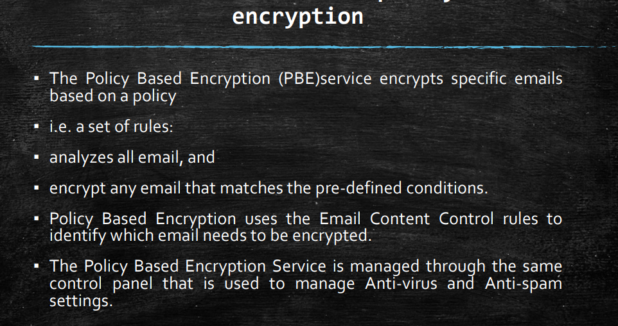
Content Control and policy based encryption

Slide 73
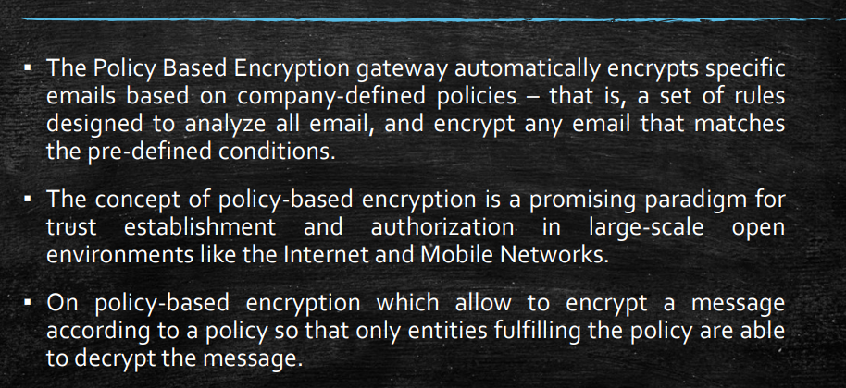
Content control and policy-based encryption

Slide 74
Content Control
Key Components of Content Control:
Content Filtering: Blocking or allowing content based on predefined criteria.
Example: A company blocks access to social media sites and non-work-related content on its network.
Data Loss Prevention (DLP): Identifying, monitoring, and protecting sensitive data to prevent unauthorized sharing or leakage.
Example: DLP systems scan emails and file transfers for sensitive information like credit card numbers and block any unauthorized attempts to send this information outside the company.
Access Controls: Restricting access to content based on user roles and permissions.
Example: Only HR personnel have access to employee personal data files.
Content Classification: Tagging and categorizing content based on its sensitivity and importance.
Example: Documents are labeled as “Public,” “Internal Use Only,” “Confidential,” or “Top Secret.”
Monitoring and Reporting: Tracking content usage and access patterns to identify and respond to potential security threats.
Example: Logging all access attempts to sensitive documents and generating alerts for unusual access patterns.

Slide 75
Policy based encryption
Policy-based encryption involves using organizational policies to determine how and when data should be encrypted.
This ensures that sensitive information is protected according to predefined rules, reducing the risk of data breaches and ensuring compliance with regulatory standards.
Key Components of Policy-Based Encryption:
Encryption Policies: Rules that dictate how data should be encrypted based on various factors such as data type, user role, and location.
Example: All emails containing financial information must be encrypted before being sent outside the organization.
Automatic Encryption: Automatically encrypting data based on policy rules without user intervention.
Example: Files saved in specific folders are automatically encrypted based on their classification.
Key Management: Managing encryption keys to ensure that only authorized users can decrypt and access the data.
Example: Using a central key management system to control access to encryption keys.
Granular Encryption: Encrypting data at different levels (file, folder, database, or field level) based on the policy.
Example: Encrypting specific columns in a database that contain personally identifiable information (PII).
Compliance Enforcement: Ensuring that encryption practices meet regulatory and compliance requirements.
Example: Implementing encryption standards that comply with HIPAA.

Slide 76
Example Scenario: Combining Content Control and Policy-Based Encryption
Context:
A financial institution wants to protect sensitive customer data and ensure compliance with regulatory requirements.
Implementation:
Content Classification: The institution classifies all data based on sensitivity (e.g., customer information, transaction records, internal memos).
Policy: Customer information is classified as “Confidential.”
Content Filtering and DLP: The institution deploys DLP tools to monitor and restrict the sharing of sensitive information.
Policy: Emails containing customer information cannot be sent to external email addresses without encryption.
Access Controls: The institution restricts access to sensitive data based on user roles.
Policy: Only employees in the customer service department can access customer records.
Encryption Policies: The institution defines encryption policies for different types of data.
Policy: All customer information must be encrypted both at rest and in transit.
Automatic Encryption: The system automatically encrypts files containing customer information when they are saved to the company’s servers.
Key Management: The institution uses a centralized key management system to control access to encryption keys.
Policy: Only authorized personnel can access encryption keys, and key usage is logged and monitored.
Monitoring and Reporting: The institution continuously monitors access to sensitive data and encryption activities.
Policy: Generate alerts for any unauthorized access attempts or unusual activity patterns.

Slide 77
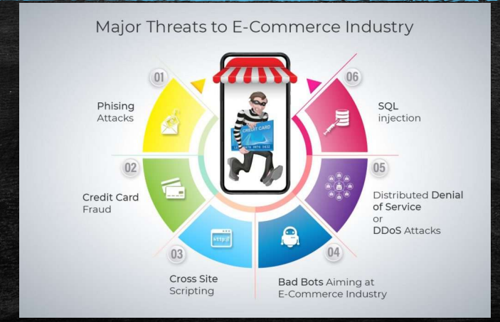
Example of security in e-commerce transaction

Slide 78
Security in e-commerce transactions is critical to protect sensitive information and ensure the integrity and privacy of the transaction process.
1. SSL/TLS Encryption
Secure Sockets Layer (SSL) and Transport Layer Security (TLS) are protocols used to encrypt data transmitted between the user’s browser and the e-commerce server. This ensures that any information exchanged, such as credit card details and personal information, is secure from interception by third parties.
Example: An e-commerce website uses SSL/TLS to secure the checkout process, indicated by the "https" in the URL and a padlock icon in the browser address bar.

Slide 79
2. Payment Card Industry Data Security Standard (PCI DSS) Compliance
PCI DSS is a set of security standards designed to ensure that all companies that process, store, or transmit credit card information maintain a secure environment.
Example: An online retailer adheres to PCI DSS requirements by not storing credit card information on its servers and using tokenization to replace card details with a unique identifier.
3. Two-Factor Authentication (2FA)
Two-factor authentication adds an extra layer of security by requiring users to provide two forms of identification before completing a transaction.
Example: After entering their password, a user must enter a one-time code sent to their mobile phone to complete a purchase on an e-commerce site.

Slide 80
4. Tokenization
Tokenization replaces sensitive data, such as credit card numbers, with a unique identifier or token that cannot be used outside the specific context in which it was created.
Example: When a customer saves their payment information on an e-commerce site, the site stores a token rather than the actual credit card number.
5. Secure Payment Gateways
Payment gateways securely process credit card transactions by encrypting and securely transmitting transaction information to the payment processor.
Example: An e-commerce platform integrates with a secure payment gateway like PayPal, Stripe, or Square to handle all payment processing.

Slide 81
6. Fraud Detection and Prevention Systems
These systems use algorithms and machine learning to detect and prevent fraudulent transactions by analyzing patterns and flagging suspicious activities.
Example: An online store uses a fraud detection system that flags a purchase attempt from a country different from the billing address for manual review.
7. Secure User Authentication
Implementing strong user authentication methods, such as biometric authentication or complex passwords, helps secure user accounts.
Example: An e-commerce app allows users to log in using fingerprint recognition on their smartphones.
8. Digital Signatures
Digital signatures verify the authenticity and integrity of electronic documents and transactions, ensuring they have not been tampered with.
Example: A customer digitally signs a contract for a subscription service, which is verified by the e-commerce platform before processing.

Slide 82
9. End-to-End Encryption
End-to-end encryption ensures that data is encrypted on the sender’s device and only decrypted on the recipient’s device, preventing intermediaries from accessing it.
Example: A messaging service integrated into an e-commerce platform uses end-to-end encryption to secure communication between buyers and sellers.
10. Regular Security Audits and Vulnerability Assessments
Conducting regular security audits and vulnerability assessments helps identify and fix security weaknesses in e-commerce systems.
Example: An e-commerce company performs quarterly security audits and employs ethical hackers to conduct penetration testing on their website.

Slide 83
Example
Example Scenario: A Secure E-Commerce Transaction
Customer Browsing: A customer visits an e-commerce website to purchase a product. The website uses SSL/TLS to encrypt data between the customer’s browser and the server.
Account Login: The customer logs into their account using two-factor authentication, entering their password and a one-time code sent to their phone.
Adding to Cart and Checkout: The customer adds items to their cart and proceeds to checkout. The e-commerce platform uses a secure payment gateway to handle the transaction.
Payment Processing: The customer enters their payment information, which is tokenized and sent to the payment processor via the secure payment gateway.
Order Confirmation: Once the payment is processed, the customer receives an order confirmation. The e-commerce system logs the transaction and monitors it for any signs of fraud.
Shipping and Delivery: The order is shipped to the customer, who can track the shipment through an end-to-end encrypted communication channel provided by the e-commerce platform.

Slide 84
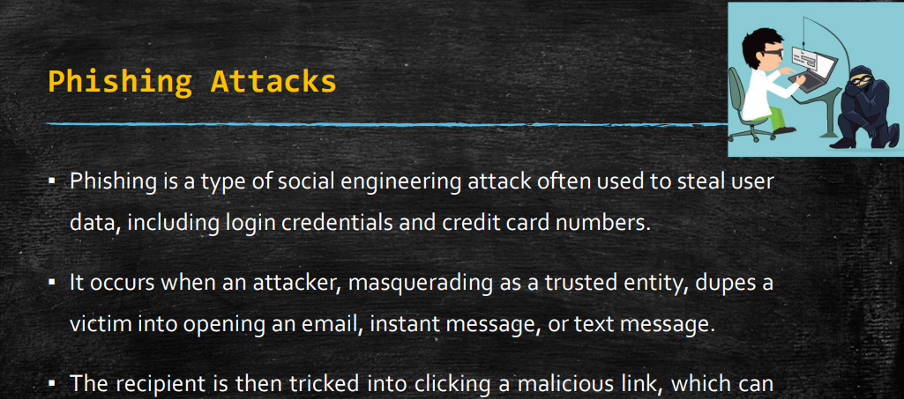
Phishing attack

Slide 85
Phishing attack
Phishing attacks are a type of social engineering where attackers attempt to deceive individuals into providing sensitive information such as usernames, passwords, and credit card details by masquerading as a trustworthy entity in electronic communications.
Phishing attacks typically use email, social media, phone calls, or fraudulent websites to trick victims into divulging their information.
Key Characteristics of Phishing Attacks:
Deceptive Communication: Phishing attacks often involve communications that appear to come from a legitimate source, such as a bank, an online retailer, or a trusted service provider.
Urgency and Fear: Attackers create a sense of urgency or fear to prompt quick action from the victim. This could be a warning about a security breach, a problem with the account, or a time-sensitive offer.
Malicious Links and Attachments: Phishing emails and messages often contain links to fake websites or attachments that install malware when opened.
Requests for Sensitive Information: The ultimate goal of a phishing attack is to obtain sensitive information. Victims are typically asked to enter their credentials, financial information, or personal details.

Slide 86
Example of a Phishing Attack
Scenario: Phishing Email Targeting Online Banking Customers
The Setup:
An attacker creates a fake email that appears to come from a legitimate bank. The email is designed to look identical to official communications from the bank, using the bank's logo, color scheme, and formatting.
The Bait:
The email contains a message warning the recipient that there has been suspicious activity on their account, and immediate action is required to secure their account. The email includes a sense of urgency to provoke an emotional reaction and prompt quick action without careful consideration.
Example Subject Line: "Immediate Action Required: Suspicious Activity Detected on Your Account"
The Hook:
The email includes a link that supposedly directs the recipient to the bank's website to verify their account information and secure their account. However, the link actually leads to a fake website controlled by the attacker.
The Fake Website:
The fake website is a replica of the bank's official website, designed to trick the recipient into believing it is genuine. The URL might be similar to the bank’s real URL but with slight differences (e.g., "www.bank-secure.com" instead of "www.bank.com").
The Attack:
When the recipient clicks the link and is redirected to the fake website, they are prompted to log in by entering their username and password. They might also be asked to provide additional information, such as their Social Security number, security questions, or credit card details.
The Consequence:
Once the recipient enters their information, it is captured by the attacker. The attacker can then use this information to gain unauthorized access to the victim's real bank account, potentially leading to financial loss and identity theft.

Slide 87
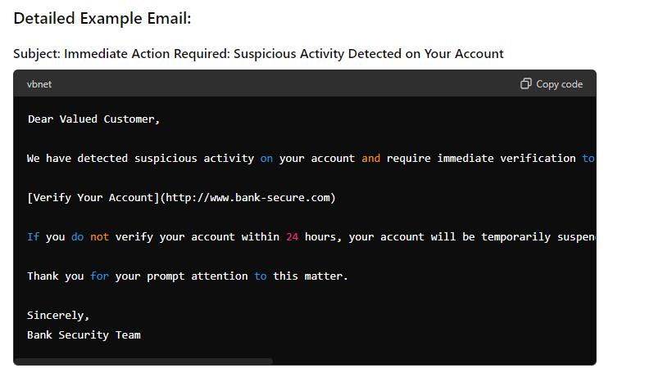

Slide 88
How to Identify and Avoid Phishing Attacks:
Check the Sender’s Email Address: Look closely at the sender's email address. Phishing emails often come from addresses that are similar to, but not exactly the same as, official email addresses.
Example: An email from "security@bank-secure.com" instead of "security@bank.com".
Hover Over Links: Hover your mouse over any links in the email (without clicking) to see the actual URL. Be cautious if the URL is not clearly related to the legitimate organization.
Example: Hovering over "Verify Your Account" shows "http://www.bank-secure.com" instead of the bank's official website.
Look for Spelling and Grammar Mistakes: Phishing emails often contain spelling and grammatical errors, which are uncommon in official communications from legitimate organizations.
Be Wary of Urgent Requests: Phishing attacks often create a sense of urgency to prompt quick action. Legitimate organizations typically do not request sensitive information through email.
Verify with the Organization: If you receive a suspicious email, contact the organization directly using a known, trusted method (e.g., their official website or customer service number) to verify the request.
Use Security Software: Keep your computer's security software up to date to help detect and block phishing attacks.

Slide 89
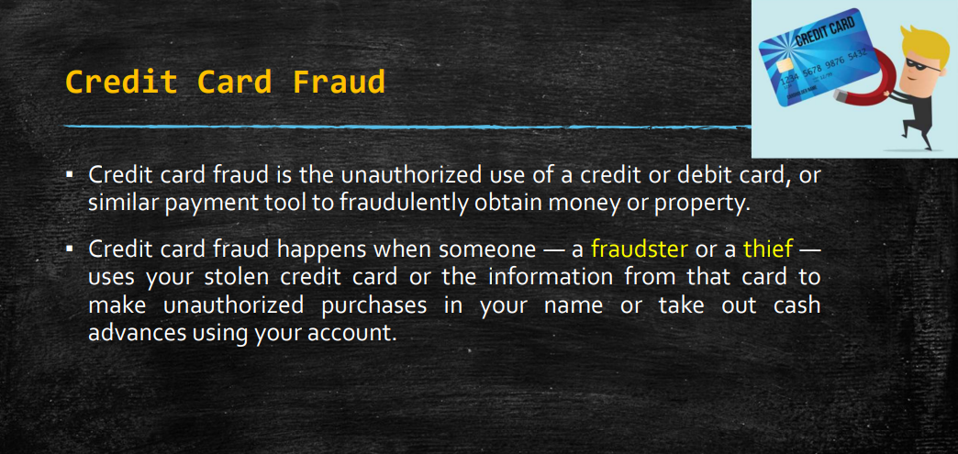
Credit card fraud

Slide 90
Credit card fraud
Credit card fraud is a type of theft involving the unauthorized use of someone else's credit card information to make purchases, withdraw funds, or obtain unauthorized benefits. This can occur through various methods, including physical theft of the card, online fraud, phishing attacks, and data breaches.
Example of Credit Card Fraud
Scenario: Online Credit Card Fraud through a Data Breach
The Data Breach:
An attacker gains unauthorized access to a large retail company's database through a security vulnerability. The database contains customer information, including names, addresses, and credit card details.

Slide 91
Example of Credit Card Fraud
Scenario: Online Credit Card Fraud through a Data Breach
The Data Breach:
An attacker gains unauthorized access to a large retail company's database through a security vulnerability. The database contains customer information, including names, addresses, and credit card details.
Harvesting Credit Card Information:
The attacker extracts the credit card information of thousands of customers from the compromised database. This information includes credit card numbers, expiration dates, and CVV codes.
Selling Information on the Dark Web:
The stolen credit card information is sold on the dark web to other cybercriminals who specialize in credit card fraud.
Making Unauthorized Purchases:
Cybercriminals use the stolen credit card information to make unauthorized purchases online. They typically buy high-value items like electronics, which can be easily resold for cash.

Slide 92
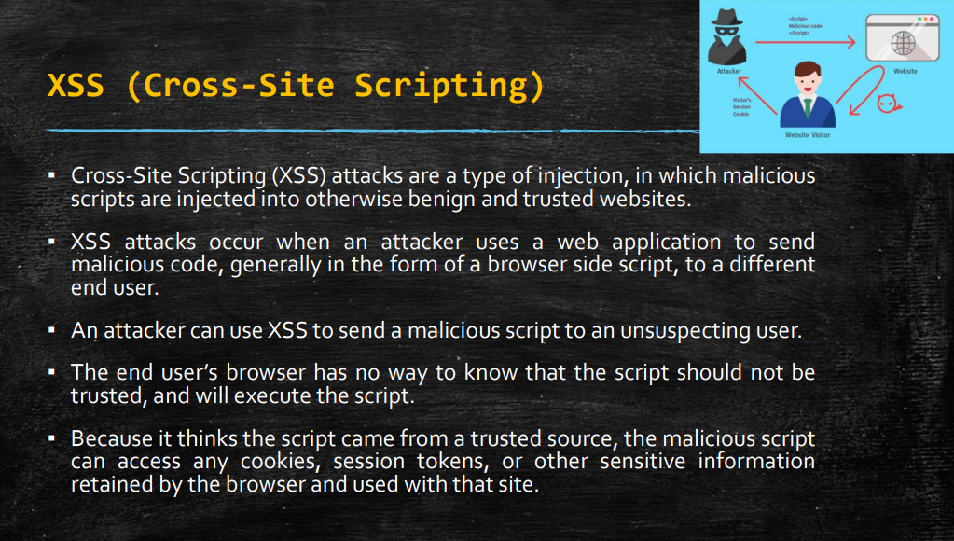

Slide 93
XSS
Cross-Site Scripting (XSS) is a type of security vulnerability typically found in web applications. It allows attackers to inject malicious scripts into webpages viewed by other users.
These scripts can then be executed in the context of the user's browser, potentially leading to data theft, session hijacking, and other malicious activities.
Types of XSS
Stored XSS (Persistent XSS): The malicious script is permanently stored on the target server, such as in a database, message forum, visitor log, or comment field.
Reflected XSS (Non-Persistent XSS): The malicious script is reflected off a web server, typically in an error message, search result, or any other response that includes some or all of the input sent to the server as part of the request.
DOM-Based XSS: The vulnerability is in the client-side code rather than the server-side code. The attack is executed as a result of modifying the DOM environment in the victim’s browser.

Slide 94
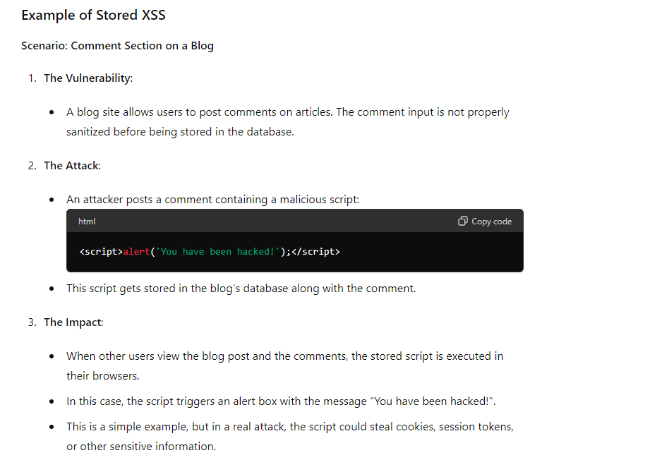
Example

Slide 95
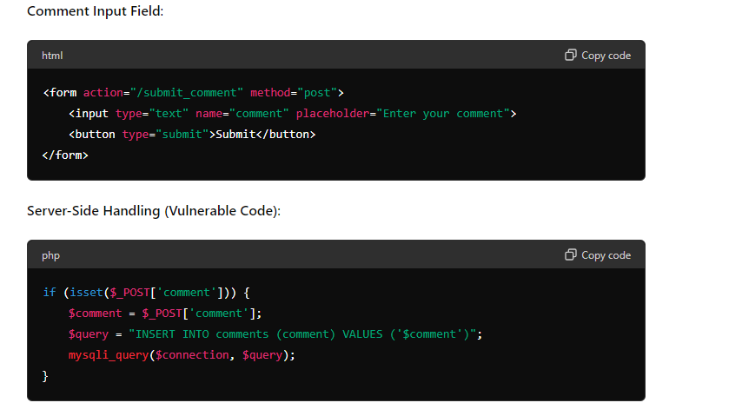

Slide 96
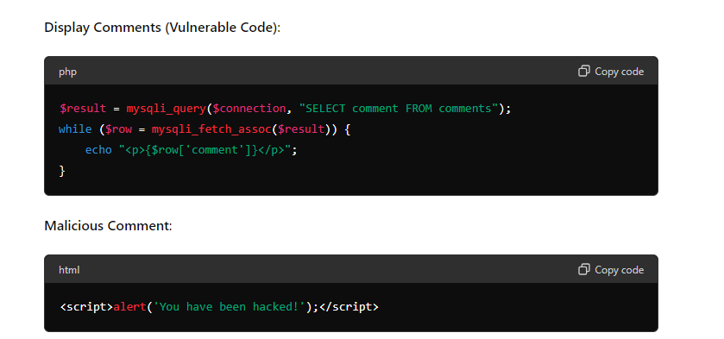

Slide 97
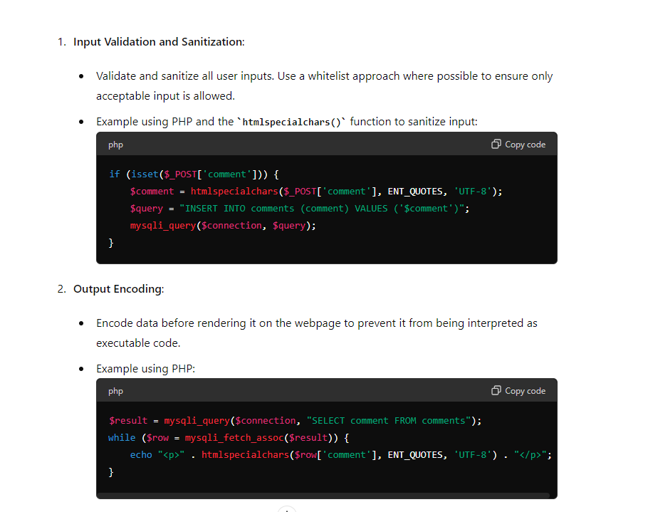
How to prevent XSS

Slide 98
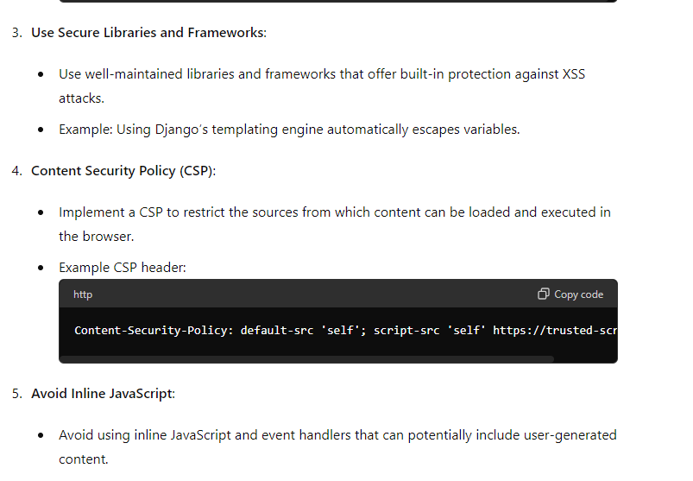
How to prevent XSS

Slide 99
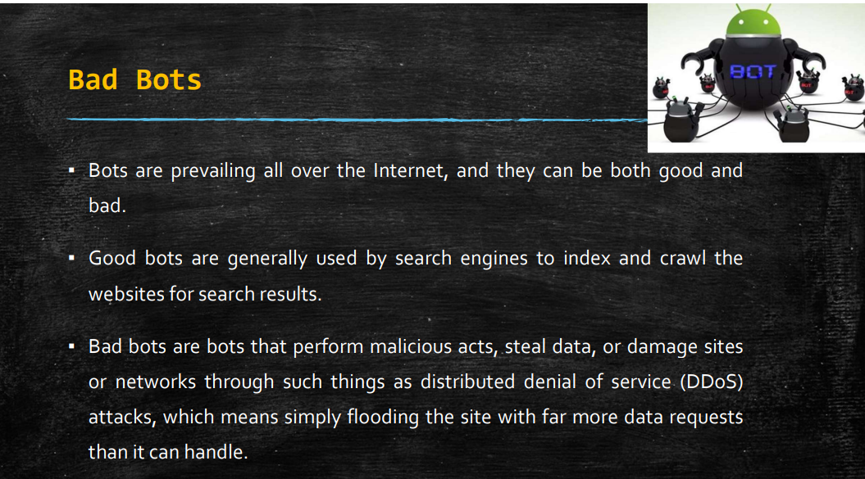
Bad bots

Slide 100
Bad bots
Bad bots" refer to automated programs or scripts that interact with web applications or services for malicious purposes.
These bots often perform activities that are harmful to websites, servers, or users, such as scraping content, launching DDoS attacks, committing fraud, or exploiting vulnerabilities.
Here are some examples of bad bots and their activities:
1. Web Scrapers
Activity: Scraping website content without permission for various purposes such as content theft, price scraping, or market research.
Example: A bot continuously scrapes product listings and pricing information from an e-commerce website to replicate the data on another site.

Slide 101
Bad bots
2. DDoS Bots
Activity: Participating in Distributed Denial of Service (DDoS) attacks by flooding servers with overwhelming traffic, causing them to become inaccessible to legitimate users.
Example: A botnet consisting of thousands of compromised devices launches a DDoS attack on a financial institution's website, disrupting its services.
3. Spambots
Activity: Generating and disseminating spam messages across various platforms, including email, forums, comments sections, and social media.
Example: A bot floods comment sections of blogs and forums with spammy links to promote pharmaceutical products or other dubious services.

Slide 102
Bad bots
4. Credential Stuffing Bots
Activity: Automating login attempts using stolen or leaked credentials to gain unauthorized access to user accounts.
Example: A botnet attempts to log in to online banking or e-commerce accounts using combinations of usernames and passwords obtained from data breaches.
5. Click Fraud Bots
Activity: Generating fraudulent clicks on online advertisements or affiliate links to artificially inflate revenue or exhaust advertisers' budgets.
Example: A bot repeatedly clicks on pay-per-click advertisements displayed on a website, causing advertisers to pay for non-legitimate traffic.

Slide 103
SQL Injection
SQL injection is a type of cyber attack where an attacker injects malicious SQL code into input fields or parameters of a web application, exploiting vulnerabilities in the application's database layer.
This allows the attacker to execute arbitrary SQL commands, potentially leading to unauthorized access, data manipulation, or data exfiltration from the database.

Slide 104
import sqlite3
# Connect to SQLite database (or create it if it doesn't exist)
connection = sqlite3.connect('example.db')
cursor = connection.cursor()
# Create users table
cursor.execute('''CREATE TABLE IF NOT EXISTS users (username TEXT, password TEXT)''')
# Insert a sample user
cursor.execute("INSERT INTO users (username, password) VALUES ('admin', 'password123')")
connection.commit()
# Function to simulate user login
def login(username, password):
# Vulnerable SQL query
query = f"SELECT * FROM users WHERE username = '{username}' AND password = '{password}'"
cursor.execute(query)
result = cursor.fetchall()
if result:
print("Login successful!")
else:
print("Invalid username or password.")
# User input (normal case)
username = input("Enter username: ")
password = input("Enter password: ")
login(username, password)
# Close the connection
connection.close()
Vulnerable python code

Slide 105
SQL Injection ATTACK
An attacker can exploit this by injecting SQL through the input fields.
Username: ‘admin’
Password: ‘’ OR ‘1’=‘1’
SELECT * FROM users
WHERE username = 'admin’
AND
password = '' OR '1'='1’;
When the script is run with this, it will always return a successful login because ‘OR ‘1’=‘1’ is always true.

Slide 106
import sqlite3
# Connect to SQLite database (or create it if it doesn't exist)
connection = sqlite3.connect('example.db')
cursor = connection.cursor()
# Create users table
cursor.execute('''CREATE TABLE IF NOT EXISTS users (username TEXT, password TEXT)''')
# Insert a sample user
cursor.execute("INSERT INTO users (username, password) VALUES ('admin', 'password123')")
connection.commit()
# Function to simulate user login
def login(username, password):
# Secure SQL query using parameterized queries
query = "SELECT * FROM users WHERE username = ? AND password = ?"
cursor.execute(query, (username, password))
result = cursor.fetchall()
if result:
print("Login successful!")
else:
print("Invalid username or password.")
# User input (normal case)
username = input("Enter username: ")
password = input("Enter password: ")
login(username, password)
# Close the connection
connection.close()

Slide 107
Key Points
Parameterized Queries:
Use placeholders (? in SQLite) to ensure the database treats user input as data, not executable code.

Slide 108
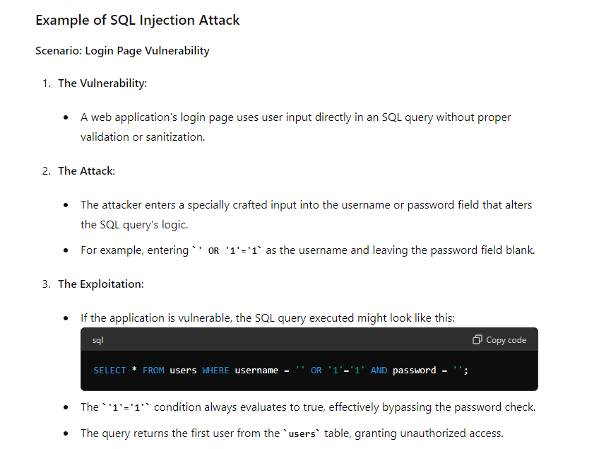
Example

Slide 109
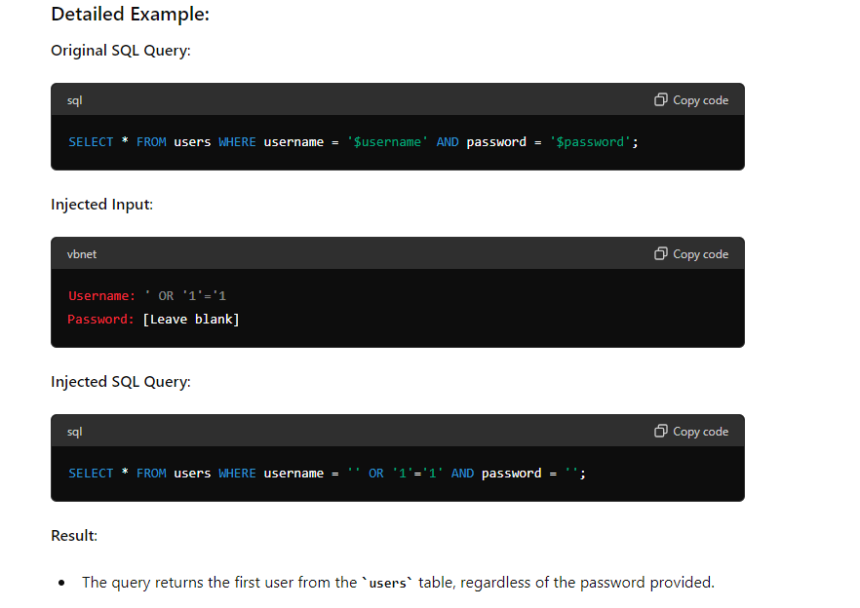

Slide 110
Impacts
Impact of SQL Injection
Unauthorized Access: Attackers can bypass authentication mechanisms and gain unauthorized access to sensitive data or administrative accounts.
Data Leakage: Attackers can extract sensitive information such as usernames, passwords, credit card details, or personal information stored in the database.
Data Manipulation: Attackers can modify, delete, or insert data into the database, altering the application's behavior or compromising data integrity.
Server Compromise: In extreme cases, attackers can execute system-level commands through SQL injection, leading to server compromise or further exploitation.

Slide 111
Prevent SQL injection
Prevention of SQL Injection
Parameterized Queries (Prepared Statements):
Use parameterized queries or prepared statements with placeholders to separate SQL code from user input.
Input Validation and Sanitization:
Validate and sanitize user input to ensure it conforms to expected formats and does not contain malicious characters.
Least Privilege Principle:
Limit database user privileges to only those necessary for the application to function, reducing the potential impact of successful SQL injection attacks.
Web Application Firewalls (WAF):
Implement WAFs to filter and block malicious HTTP requests, including those attempting SQL injection attacks.
Database Security Measures:
Implement strong authentication mechanisms, encrypt sensitive data, and regularly update and patch database software to mitigate vulnerabilities.
Security Testing and Code Review:
Conduct regular security testing, including penetration testing and code reviews, to identify and remediate SQL injection vulnerabilities.

Slide 112
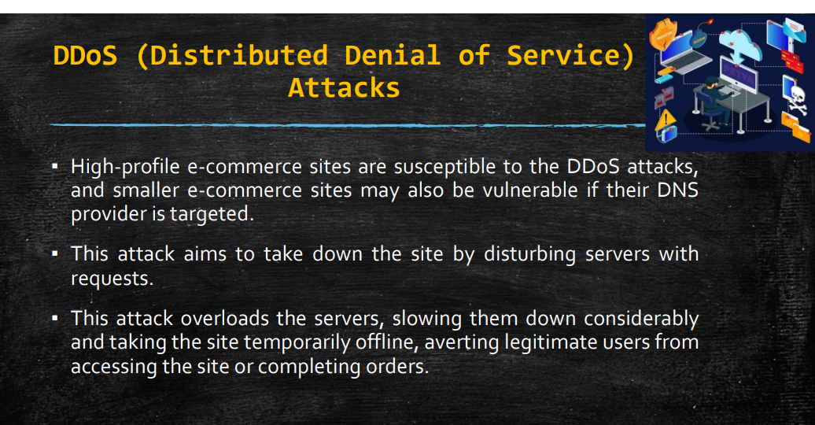

Slide 113
DDOS
A Distributed Denial of Service (DDoS) attack is a malicious attempt to disrupt the normal traffic of a targeted server, service, or network by overwhelming it with a flood of internet traffic.
DDoS attacks typically involve multiple compromised devices, often distributed across different geographic locations, acting in concert to generate excessive traffic.
The goal of a DDoS attack is to render the target inaccessible to legitimate users, causing service disruptions, downtime, or financial losses.

Slide 114
Key Characteristics of DDoS Attacks:
Distributed Nature: DDoS attacks involve a large number of compromised devices, often referred to as botnets, which are coordinated to flood the target with traffic from multiple sources.
Multiple Attack Vectors: DDoS attacks can employ various techniques and protocols to generate traffic, including UDP, TCP, ICMP, HTTP, and DNS, among others.
Volume, Velocity, and Variety: DDoS attacks can vary in terms of the volume of traffic generated, the speed at which it is delivered, and the variety of attack vectors used, making them challenging to mitigate.
Layered Approach: DDoS attacks can target different layers of the OSI model, including the network layer (Layer 3), transport layer (Layer 4), and application layer (Layer 7), each requiring different mitigation strategies.

Slide 115
Example
Example of a DDoS Attack:
Scenario: Network Layer (Layer 3) DDoS Attack
Preparation:
An attacker compromises a large number of IoT devices, such as webcams or routers, by exploiting known vulnerabilities or using default credentials.
Coordination:
The attacker installs malware on the compromised devices, turning them into bots or zombies that can be controlled remotely.
Execution:
The attacker instructs the botnet to initiate a DDoS attack against a specific target, such as a website or online service.
Attack:
The compromised devices flood the target with a massive volume of spoofed traffic, overwhelming its network infrastructure and causing it to become unresponsive.
Impact:
The target's website or service experiences downtime or reduced performance, resulting in service disruptions, loss of revenue, and damage to its reputation.

